Slide 1
Chapter 21-Time Division Multiplexing

Slide 2
Introduction
Time-division multiplexing (TDM) is a digital process that allows several connections to share the high bandwidth of a line.
Instead of sharing a portion of the bandwidth as in FDM, time is shared. Each connection occupies a portion of time in the link.
Note that the same link is used as in FDM; here, however, the link is shown sectioned by time rather than by frequency.
In the figure, portions of signals 1, 2, 3, and 4 occupy the link sequentially.

Slide 3

Cont.

Slide 4
Cont.
All the data in a message from any source always go to one specific destination, be it 1, 2, 3, or 4.
We also need to remember that TDM is, in principle, a digital multiplexing technique.
Digital data from different sources are combined into one timeshared link.
However, this does not mean that the sources cannot produce analog data; analog data can be sampled, changed to digital data, and then multiplexed by using TDM.

Slide 5
Cont.
We can divide TDM into two different schemes: synchronous and statistical.
In synchronous TDM, each input connection has an allotment in the output even if it is not sending data.

Slide 6
Time Slots and Frames
In synchronous TDM, the data flow of each input connection is divided into units.
The size of the unit can be 1 bit, or several bits.
For n input connections, a frame is organized into a minimum of n time slots.

Slide 7

Cont.
Figure below shows an example where n is 3

Slide 8
Cont.
In TDM, the data rate of the link that carries data from n connections must be n times the data rate of a connection to guarantee the flow of data.
The duration of a unit in a connection is n times the duration of a time slot in frame.
In the above figure, the data rate of the link is 3 times the data rate of a connection; likewise, the duration of a unit on a connection is 3 times that of the time slot.
In figure we represent the data prior to multiplexing as 3 times the size of the data after multiplexing.

Slide 9
Problem
Four 1-Kbps connections are multiplexed together. A unit is 1 bit. Find (1) the duration of 1 bit before multiplexing, (2) the transmission rate of the link, (3) the duration of a frame? and (4) the duration of a time slot,
Solution
The duration of 1 bit is 1/1 Kbps, or 0.001 s (1 ms).
The rate of the link is 4 Kbps.
The duration of a frame 1 ms.
The duration of each time slot 1/4 ms or .25 ms

Slide 10
Interleaving
The process of taking a group of bits from each input line for multiplexing is called interleaving.
TDM can be visualized as two fast-rotating switches, one on the multiplexing side and the other on the demultiplexing side.
The switches are synchronized and rotate at the same speed, but in opposite directions.
On the multiplexing side, as the switch opens in front of a connection, that connection has the opportunity to send a unit onto the path. This process is called interleaving.

Slide 11

Cont.

Slide 12

Empty Slot
Synchronous TDM is not as efficient as it could be. If a source does not have data to send, the corresponding slot in the output frame is empty.

Slide 13

Problem
Four channels are multiplexed using TDM. If each channel sends 100 bytes /s and we multiplex 1 byte per channel, show the frame traveling on the link, the size of the frame, bit rate of the link, frame rate, and the duration of a frame.
Solution

Slide 14
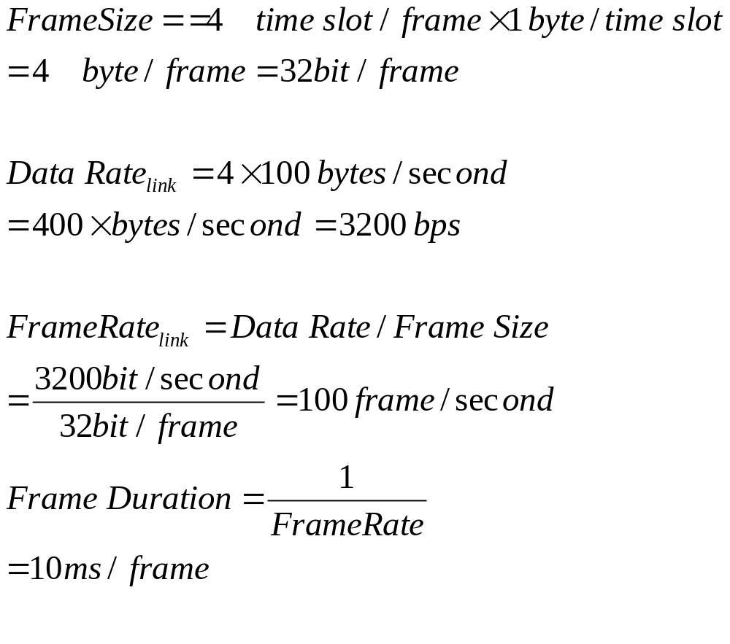
Solution

Slide 15

Problem
A multiplexer combines four 100-kbps channels using a time slot of 2 bits. Show the output with four arbitrary inputs. What is the frame rate? What is the frame duration? What is the bit rate at the link? What is the bit duration at the link?

Slide 16
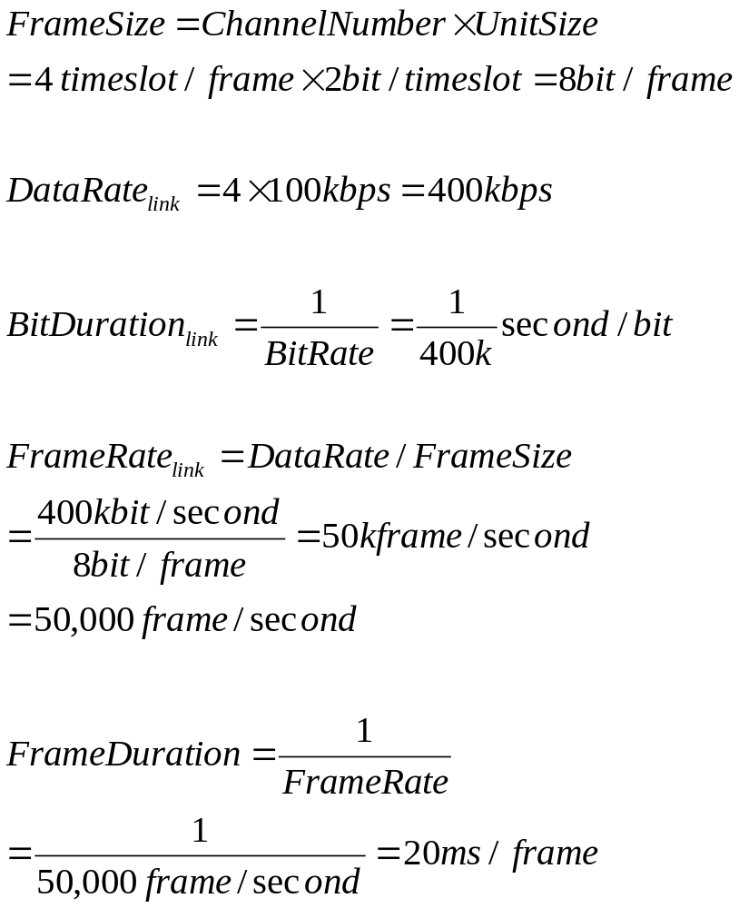
Solution

Slide 17
Data Rate Management
One problem with TDM is how to handle a disparity in the input data rates. In all our discussion so far, we assumed that the data rates of all input lines were the same. However, if data rates are not the same, three strategies, or a combination of them, can be used. We call these three strategies multilevel multiplexing, multiple-slot allocation, and pulse stuffing.

Slide 18

Multilevel multiplexing
Multilevel multiplexing is a technique used when the data rate of an input line is a multiple of others. For example, in Figure, we have two inputs of 20 kbps and three inputs of 40 kbps. The first two input lines can be multiplexed together to provide a data rate equal to the last three. A second level of multiplexing can create an output of 160 kbps.

Slide 19

Multiple-Slot Allocation
Sometimes it is more efficient to allot more than one slot in a frame to a single input line. For example, we might have an input line that has a data rate that is a multiple of another input. In Figure, the input line with a 50-kbps data rate can be given two slots in the output. We insert a serial-to-parallel converter in the line to make two inputs out of one.

Slide 20

Pulse Stuffing
Sometimes the bit rates of sources are not multiple integers of each other. Therefore, neither of the above two techniques can be applied. One solution is to make the highest input data rate the dominant data rate and then add dummy bits to the input lines with lower rates. This will increase their rates. This technique is called pulse stuffing, bit padding, or bit stuffing. The input with a data rate of 46 is pulse-stuffed to increase the rate to 50 kbps. Now multiplexing can take place.

Slide 21
Problem
Two channels, one with a bit rate of 100 Kbps and another with a bit rate of 200 Kbps, are to be multiplexed. How this can be achieved? What is the frame rate? What is the frame duration? What is the bit rate of the link?
Solution
We can allocate one slot to the first channel and two slots to the second channel. Each frame carries 3 bits.

Slide 22
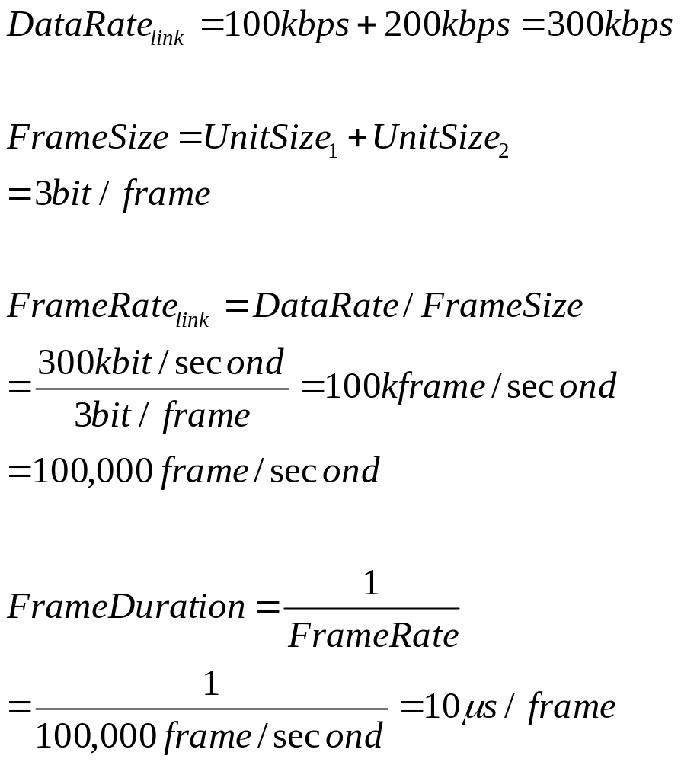
Solution

Slide 23
Question
Briefly explain the interleaving process of time-division multiplexing.
Define synchronous and statistical Time Division Multiplexing.
Explain multilevel multiplexing, multi-slot allocation and pulse stuffing techniques.
How frame synchronization is achieved in Time Division Multiplexing?
4123702 Data Communications System @YRU

